Slide 1
Script to generate testcases

Slide 2
AGENDA
. Overview
. Background
. Input file
. Python script
Functions
. Running the script
. DEMO

Slide 3
OVERVIEW
Script for test generation helps reduce time in creating multiple testcases
Doesn’t require too much attention to the register specifics of design
Makes the process of testcase generation less mechanical
Python was used as it provides a lot of packages to make it programmer friendly

Slide 4
BACKGROUND
The test case is divided into sections that need to be/ can be modified for a particular testcase. These sections are stored in separate text files.
The input parameters of the testcase are given through a csv file which has the following format.
The first column has the parameter names.
The following columns represent the values of the parameters for each train.
Each of the subsequent columns represent a train.
The script is written in python 3.7 and uses a package “pandas” which is required to be installed to run either on Windows or Linux
Note: This does not use regular expressions but just string operations for text manipulation

Slide 5
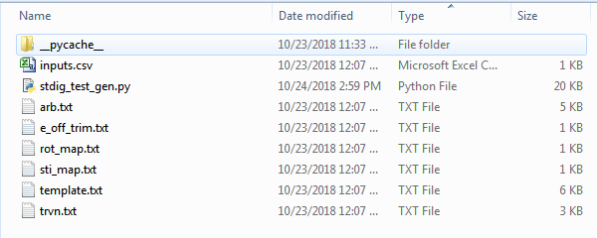

Slide 6
INPUT FILE
It is recommended to use Microsoft Excel or Libre Calc for ease in providing inputs
The parameters here corresponds to the most commonly used parameters that are provided in the stim_dig spec document.
More parameters can be added as per your requirement.
However the function that enables assignment in the testcase needs to be added in the script
The particular parameters can explained during the demo

Slide 7
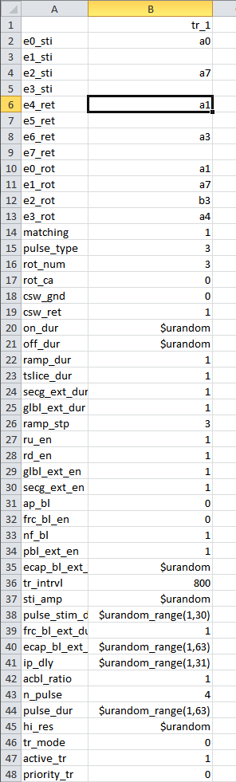
INPUT FILE

Slide 8
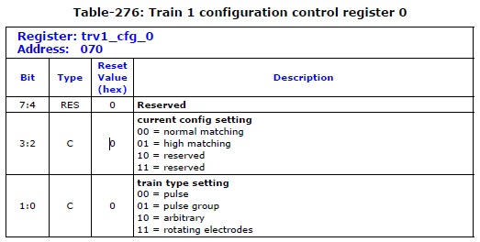
PYTHON SCRIPT
The script reads and stores data from 6 TEXT files, each is a section of the SV test code
Functions are defined to read values from the CSV file and manipulate them to write to the register
For example, Consider Train1 config reg 0

Slide 9
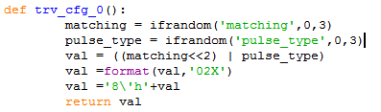
EXAMPLE FUNCTIONS
This function defined in the script reads the value from the csv file and performs bit manipulation to program the register as shown below
Here the function ifrandom checks if the parameter is random in the input file and generates a random value within the limits if true.

Slide 10
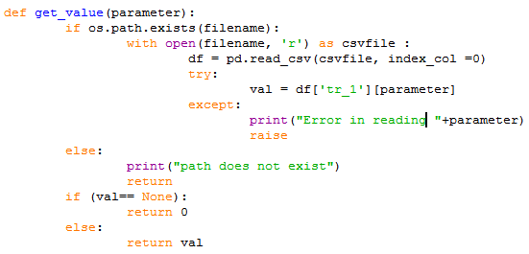
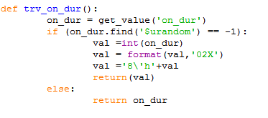
EXAMPLE FUNCTIONS
Another function that is important and can be used in functions for other registers is the get_value function, which retrieves the value from the csv file.
This can be used to add more parameters in the future

Slide 11
RUNNING THE SCRIPT
Currently the script allows the specification of the testname, path where the test is to be stored, number of trains, the input csv file.
Provisions will be made to randomize a particular parameter based on the testcase
Currently the script is incapable of generating testcases that have more than one train, this should be implemented soon.
Therefore, sequential, interleave and multi train modes are done manually for now
The command looks as follows in the linux environment
$ python stdig_test_gen.py -option input
Any other suggestions are welcome

